Slide 1


Automated Code Generation for Software Development
Welcome to this presentation on automated code generation for software development. We'll explore how AI-powered tools can revolutionize the software development process.

Slide 2

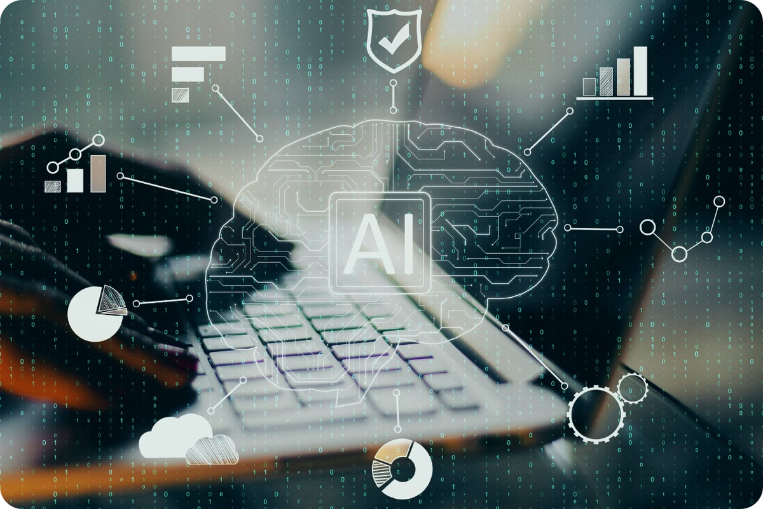
AI-Powered Tool for Efficient Code Generation and Enhancement
Efficient Code Generation
Code Enhancement
AI-powered code generation tools analyze user requirements and generate code automatically, reducing the time and effort needed for manual coding.
These tools can enhance existing code by identifying areas for optimization, refactoring code for better readability and maintainability, and adding missing features.
Enhanced Productivity
By automating repetitive tasks, developers can focus on more strategic activities, such as problem-solving, design, and innovation.

Slide 3
Problem Statement: Challenges in Translating User Requirements into Code
1
Ambiguity in Requirements
2
Time-Consuming Manual Coding
3
Potential for Errors
Manual coding is prone to errors, leading to bugs and delays in the development process.
User requirements can be ambiguous or incomplete, making it difficult for developers to understand the exact functionality desired.
Translating user requirements into code can be a time-consuming process, especially for complex applications.

Slide 4

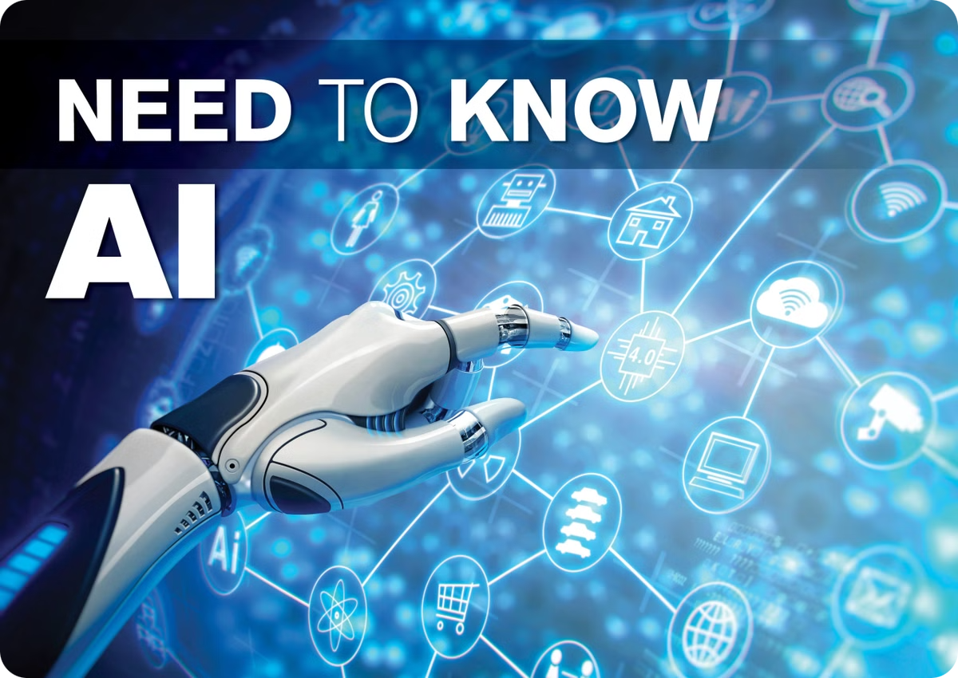
Solution Overview: AI-Powered Code Generation and Enhancement
1
Requirement Analysis
AI tools analyze user requirements using natural language processing and machine learning algorithms.
2
Code Generation
Based on the analyzed requirements, AI tools automatically generate code in the desired programming language.
3
Code Optimization
AI tools optimize the generated code for efficiency, performance, and maintainability, ensuring high-quality code.

Slide 5



Benefits: Faster Development, Improved Code Quality, and Reduced Costs
Faster Development
Improved Code Quality
Reduced Costs
AI-powered tools significantly reduce development time by automating code generation and optimization.
AI tools generate high-quality code that is optimized for performance, maintainability, and security.
By accelerating development and reducing the need for manual coding, these tools help minimize development costs.

Slide 6





GitHub Integration for Easy Code Deployment
The AI seamlessly integrates with GitHub, allowing you to effortlessly deploy your generated code to your repositories.
Code Generation
GitHub Integration
Version Control
The AI generates code based on your requirements.
The AI automatically pushes the generated code to your chosen GitHub repository.
Benefit from seamless version control, ensuring trackability and collaboration within your team.

Slide 7
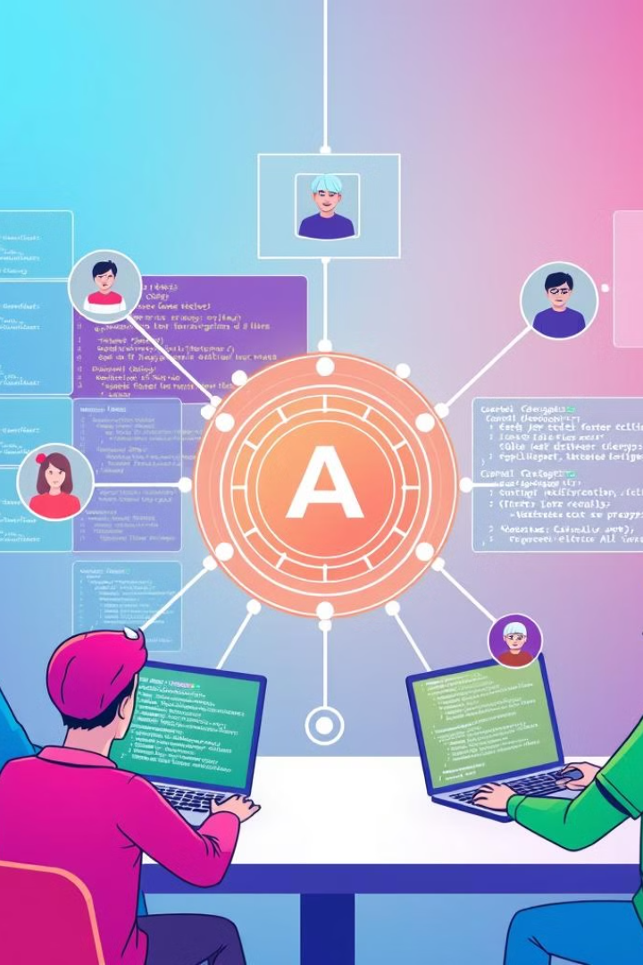
Parallel Working Space for Collaborative Development
The AI provides a collaborative environment, allowing teams to work together seamlessly and efficiently.
Shared Code Repository
A centralized space for all team members to access, modify, and contribute to the project code.
Real-Time Collaboration
The AI enables real-time collaboration, allowing team members to work concurrently and see each other's contributions.
Communication and Feedback
Integrated communication tools facilitate seamless discussion and feedback exchange within the team.

Slide 8



Conclusion and Key Takeaways
Generative AI is revolutionizing software development, empowering developers to build applications faster, more efficiently, and with greater creativity.
Accelerated Development
Enhanced Innovation
Improved Collaboration
The AI significantly reduces development time, allowing for faster delivery of software and quicker time-to-market.
Developers are freed from mundane coding tasks, enabling them to focus on innovation and explore new creative possibilities.
The AI fosters a collaborative environment, allowing teams to work together efficiently and deliver high-quality software.

